Slide 1
Time series anomaly detection using tfad with frequency domain enhancements
Name – Chinmay Gurjar (A20561457)
Machine Learning (CS584)

Slide 2
What is Anomaly detection?
Anomaly Detection is the identification of rare items, events or observations which deviate significantly from the majority of the data and do not show a well-defined behavior.
Anomaly Detection is also a process of identifying unusual pattern in the given data.
Doing this manually is inefficient and error prone.
So, there is a need for new automated methods to detect anomalies more accurately.

Slide 3
Motivation
Modern systems generate large scale time series data.
In the areas like Industrial Systems, Space Telemetry Time Series Data is generated on a large scale.
Undetected Anomalies can lead to System Failures, Financial Loss, Safety Issues, etc.
Hence, accurate anomaly detection is essential for reliability.
Does applying TCN on Time Domain Signals and trying to identify Frequency patterns really help?
Separate Frequency Domain is still a necessity?

Slide 4
What is TFAD?
TFAD is Time Frequency Anomaly Detection Model, used for detecting anomalies in time series data.
It is designed to detect abnormal patterns without explicit anomaly labels.
Rather than directly classifying anomalies, TFAD Model learns what normal behavior looks like.
Then it detects anomalies as deviations from the normal patterns.

Slide 5
TFAD Components
Temporal Convolutional Network (TCN) – To capture time related dependencies
Sliding Windows – To break time series into small segments
Space Embeddings – To convert each window into a feature vector
Distance Function – To measure similarity between patterns

Slide 6
Time Domain representation
In Time Domain, Raw Signal Values over a certain time are captured.
It captures trends, sudden spikes, and temporal patterns.
Sudden increase in sensor reading detects an anomaly.
Its limitation is to capture hidden periodic patterns.

Slide 7
Temporal convolution
TCN is Temporal Convolutional Network.
In the paper, TCN is used as a feature extractor. It converts raw time series window to an embedding.
Used for capturing short patterns and long-range dependencies.
Learns temporal and frequency patterns implicitly.
No explicit frequency patterns are learned.

Slide 8
Tfad architecture
Takes Time Series as an input, which is Multivariate Time Series from multiple sensors and a continuous stream of values over time.
Window Segmentation – Time Series data is split into sliding windows, and each window represents a small segment of time.
Embeddings using TCN – Each window is passed through TCN which extracts temporal patterns and dependencies over time. Each window is converted to embedding vector.
Model learns about normal data and anomalous windows thereby separating normal and abnormal patterns in embedding space.

Slide 9
Tfad Architecture
After training, model computes distance between anomalies using Cosine Distance and L2 Regularization Methods.
Small distance – Not Anomaly, Large Distance – Anomaly. Hence, this distance = Anomaly Score
To make a decision, we convert anomaly score to binary output, using threshold.
For each window, we get an anomaly score, 0 or 1, and we evaluate this using Precision, Recall and F1 Scores.

Slide 10
Added Frequency Domain Representation
To overcome the limitation of Time Domain, we convert signal from time to frequency domain.
This uses Fast Fourier Transform (FFT) Method.
This extracts Spectral Knowledge, Dominant Frequency, and Frequency Distribution.
This reveals hidden patterns not visible in the time domain.

Slide 11
WHY FFT Explicitly?
We add FFT to provide explicit frequency information.
TFAD acts poorly for pattern or seasonal anomalies.
FFT converts signal to frequency domain.
We combine time domain signal with the frequency domain signal.
Time domain captures local changes and frequency domain captures global changes.

Slide 12
Novel Contributions
Channel Wise Importance Weightage
Explicit Threshold Optimization
Extended Metrics – F1, Accuracy, Specificity, Balanced Accuracy, FNR, FPR, MCC
Enhanced Visualizations for detailed analysis
Logging and Checkpoint Mechanism
Fast Fourier Transform for explicit Frequency Domain

Slide 13
Challenges and future scopes (Ensemble learning)
Varying shapes of outputs with different models.
Different windowing strategies.
Varying optimal thresholds for each model.
Ensemble Learning is choosing between majority voting and weighted average.
Difficult to trace errors due to different constraints on different pipelines.

Slide 14
Datasets used
Nasa Anomaly Detection Dataset SMAP and MSL
Numenta Anomaly Dataset
NASA SMAP and MSL contains point anomalies which could be detected as pattern and seasonal anomalies. Suitable for testing time domain and frequency domain methods.
Act as multivariate time series datasets, with multiple sensor outputs and helps evaluate complex dependencies.
NAB is changed with respect to SWaT dataset for making it quite similar to multivariate dataset.
Provides a combination of artificial and real datasets.

Slide 15
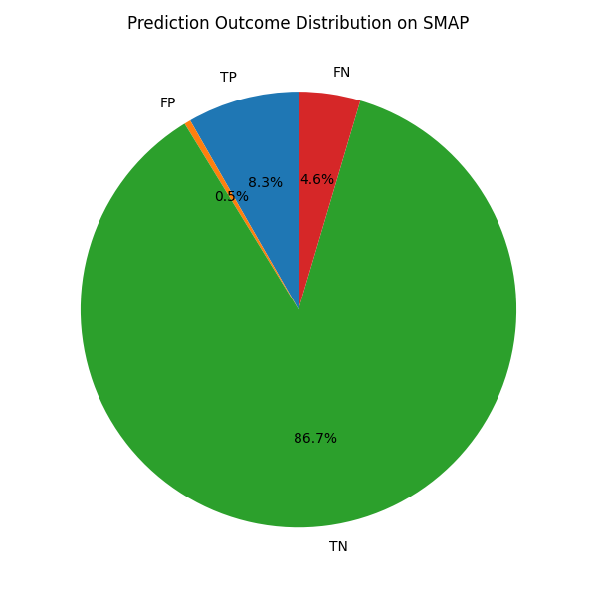
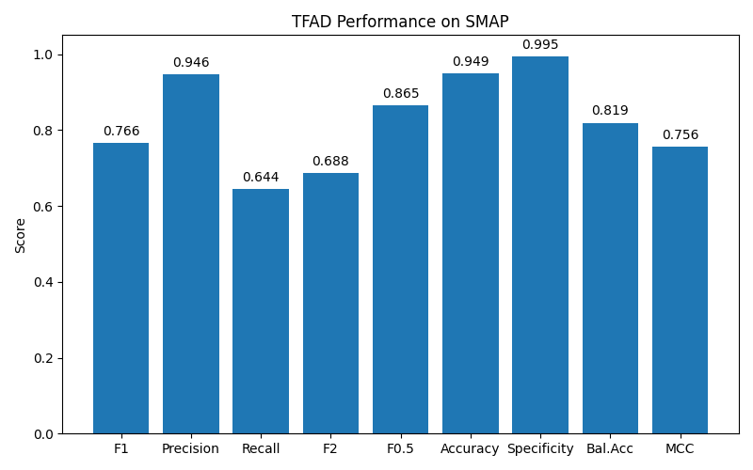
Results and observations (SMAP Baseline)

Slide 16
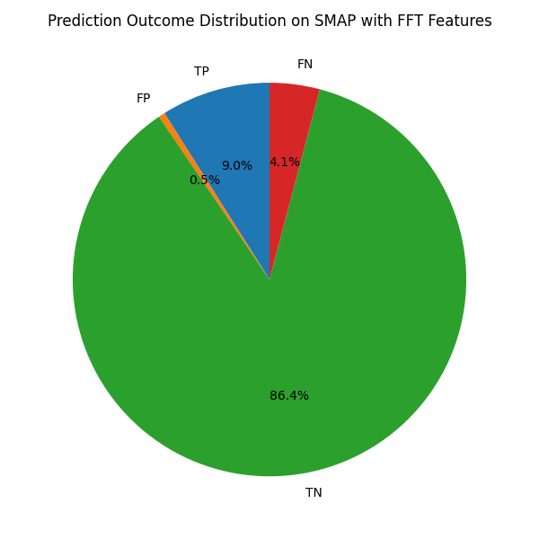
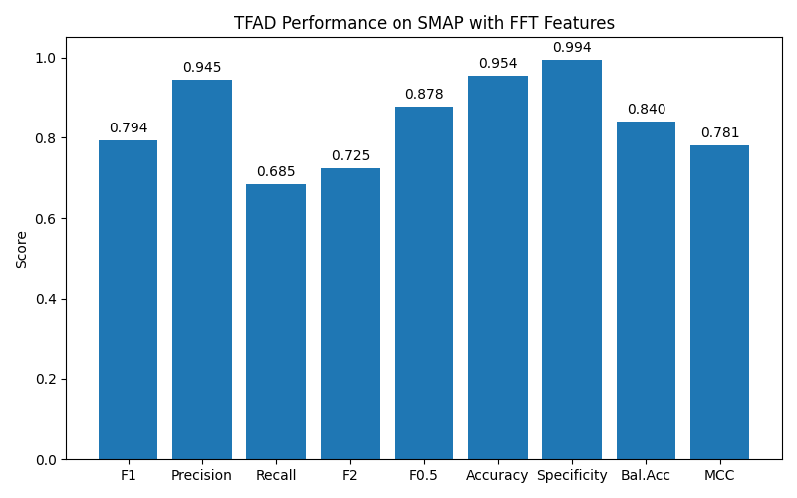
Results and observations (Smap FFT)

Slide 17
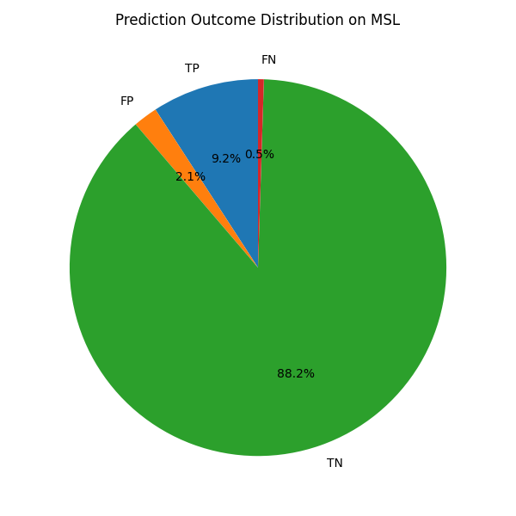
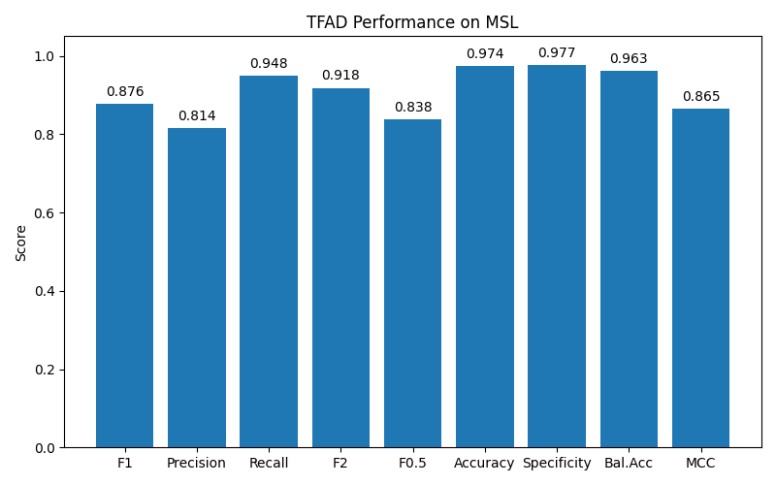
Results and observations (msl baseline)

Slide 18
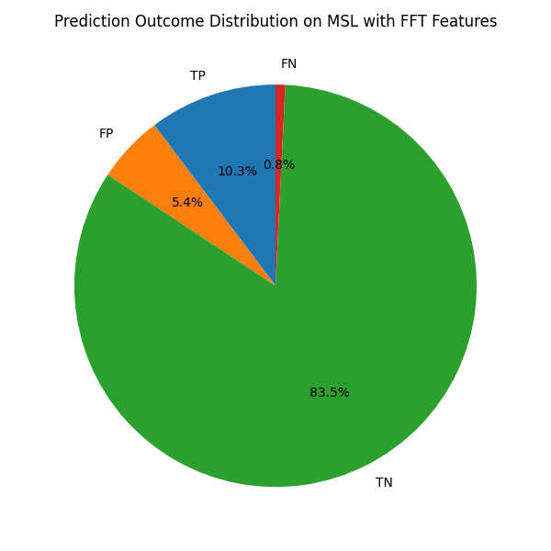
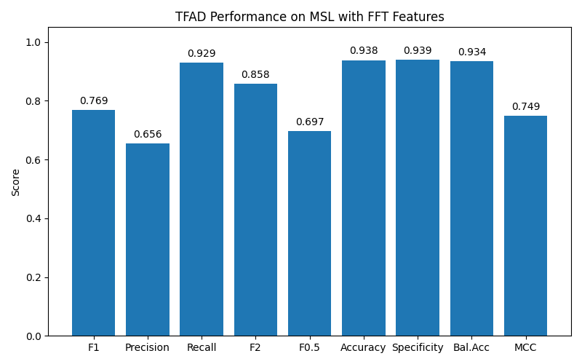
Results and observations (msl fft)

Slide 19
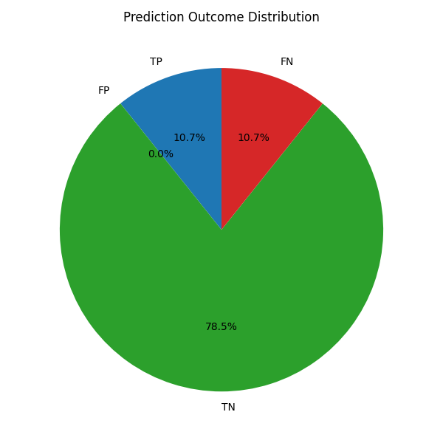
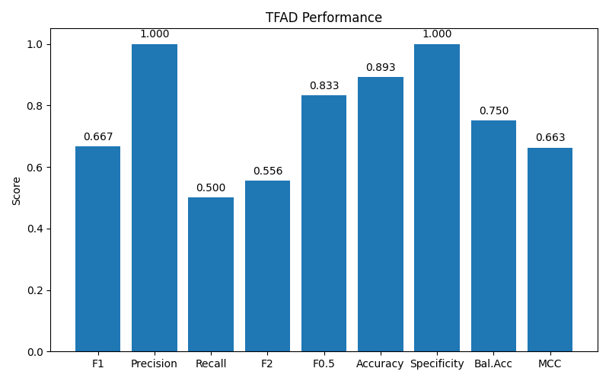
Results and observations (nab baseline)

Slide 20
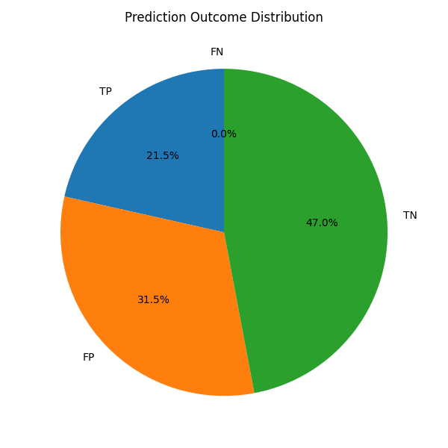
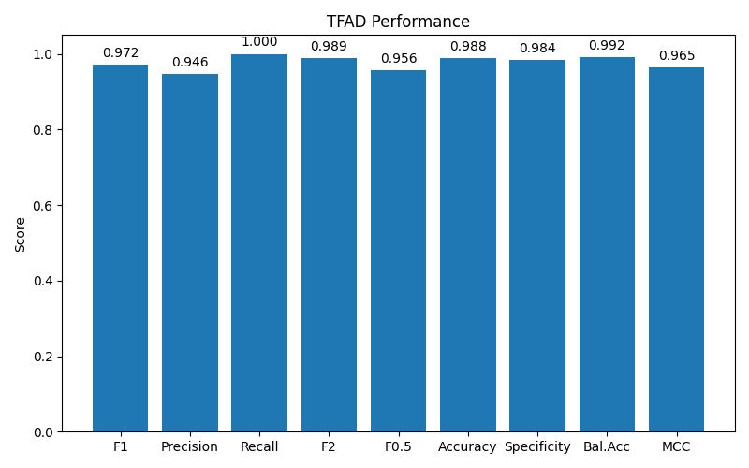
Results and observations (nab fft)

Slide 21
conclusion
In this project, we implemented and extended TFAD (Time Series Anomaly Detection) framework to evaluate its performance across multiple real-world datasets, including SMAP, MSL, NAB. The baseline model demonstrated strong performance on multivariate datasets such as MSL and NAB, where clear inter-sensor relationships enabled effective anomaly detection. However, performance on SMAP was comparatively lower due to the presence of subtle and noisy anomalies.
We also incorporated frequency-domain features using FFT, which provided additional insights into temporal patterns. The impact of FFT varied across datasets, it significantly improved performance on univariate data such as NAB by increasing anomaly detection capability, while offering limited gains on SMAP due to the complexity of its anomaly patterns. This highlights that the effectiveness of feature engineering techniques is highly dependent on dataset characteristics.
Overall, the study demonstrates that TFAD is highly effective for multivariate anomaly detection, while extensions such as FFT can further enhance performance in specific scenarios. The results emphasize the importance of dataset properties, feature representation, and threshold selection in designing robust anomaly detection systems.

Slide 22
THANK YOU!

